Slide 2
Elements of a Quality Program
1.Establish requirements and control changes: Establish and specify requirements for the quality of an product.
2. Establish and implement methods: Establish, implement, and put into practice methods, processes and procedures to develop, operate, deploy, and maintain the product.
3. Evaluate process and product quality: Establish and implement methods, processes, and procedures to evaluate the quality of the product, as well as to evaluate associated documentation, processes, and activities that have an impact on the quality of the product.

Slide 3
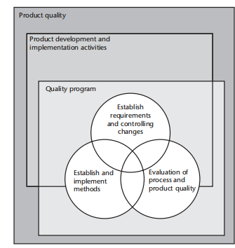
Interaction of the elements of a quality program

Slide 4
The Quality Program does not impose any organizational structure for performing the activities.
Organizations are responsible for assigning resources to accomplish the Quality Program activities. We do suggest that organizations, especially at the corporate level, avoid assigning certain roles to carry out the Quality Program
without clearly understanding the concept of product and process quality and how those are affected and implemented

Slide 5
Establish Requirements and Control Changes
The first element or set of activities of the Quality Program is to establish requirements.
Product requirements must accurately reflect the product’s desired overall quality, including functionality and performance, and must be documented and baselined (formalized).

Slide 6
when establishing baseline requirements and controlling changes, a configuration management method must be selected and later implemented in order to:
• Establish a baseline as a reasonably firm point of departure from which to proceed into the other phases of project activity knowing that there is some reasonable degree of stability in at least the set or subset of requirements that were established.
• Prevent uncontrolled changes to the product baseline.
• Improve the likelihood that the development effort results in a quality product and that processes in subsequent life-cycle phases will not degrade it.

Slide 7
2 Establish and Implement Methods
The second element or set of activities of the Quality Program involves selecting, implementing, and putting into practice the appropriate processes, practices, and methods to build quality into the product and achieve the specified quality requirements.
This is typically accomplished by codifying these processes, practices, and methods as standards and training the organization and project teams to use them

Slide 8
3 Evaluate Product and Process Quality
The third element or set of activities of the Quality Program involves both evaluating the implementation of processes and evaluating the quality of the resulting product(s). Evaluations are used to assess:
• The quality of the product;
• The adequacy of the processes and activities responsible for product quality;
• Compliance with established processes.

Slide 9
Evaluation activities include reviews, assessments, tests, analyses, inspections, and so on.
Depending on the action taken and the processes or products being evaluated, the results may be qualitative or quantitative in nature.

Slide 10
Quality Program Organizational Relationships
Type of systems;
• Mapping quality program functions to project organizational entities;
• Example implementations.

Slide 11
Mapping Quality Program Functions to Project Organizational Entities
1 Planning
The plan is produced.
• The plan is complete and the elements of the plan are integrated into the project management plan.
• The activities to be performed are integrated with each other to the extent that they should.
• The plan contains realistic schedules.
• The plan describes assignment of responsibilities and designates necessary authority to the appropriate performing organizations.
• Expected Quality Program outputs for the project are specified.
• Criteria for successful completion of tasks are stipulated

Slide 12
2 Establish Requirements and Control Changes
The quality manager uses the outputs of the assessments to:
• Ensure that the evolving requirements are modified where necessary.
• Ensure that requirements become baselined, when stable.
• Assist in revising the process of establishing requirements.
• Assist in changing methodologies used in this process.
• Enforce the procedures originally planned for this part of the Quality Program Plan.

Slide 13
.3 Establish and Implement Methods
There are really three parts to this job:
establishing the methodologies to be used for the project
(2) enforcing the methodologies
(3) modifying the selected methodologies, when necessary.

Slide 14
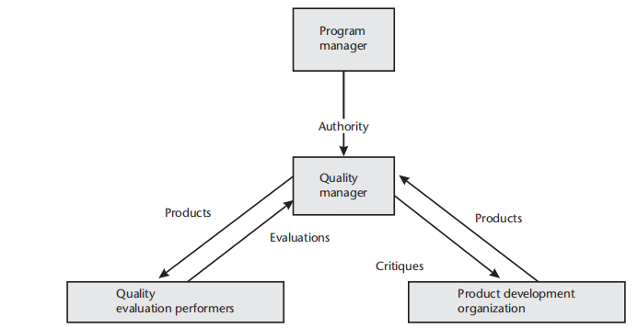
Quality manager communications

Slide 15
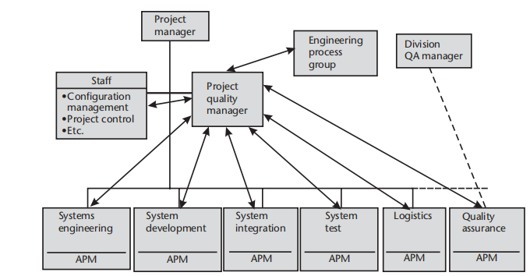
Example of a large project organization.

Slide 16
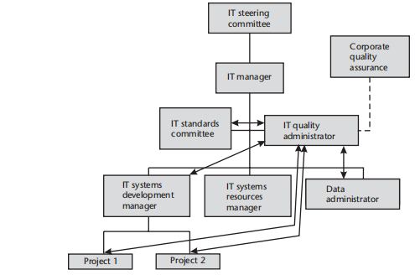
Example of a small IT organization.

Slide 17







SOFTWARE QUALITY
PROGRAM

Slide 18
SOFTWARE QUALITY PROGRAM CONCEPTS
◆ SQP stands for Software Quality program. Software Quality Program is a framework
for building quality into the software and for the actions necessary to verify that the required functionality and performance have been achieved.
◆ The Software Quality program is more than "traditional" quality assurance, It goes beyond what is normally performed by "traditional" quality assurance functions and defines th enterprise wide actions necessary for achieving quality in software development, such as:

Slide 19
software quality program is an overall approach to influence and determine the level of quality achieved in a software product. It consists of the activities necessary to:
• Establish requirements for the quality of a software product.
• Establish, implement, and enforce methodologies, processes and procedures to develop, operate, and maintain the software.
• Establish and implement methodologies, processes, and procedures to evaluate the quality of a software product and to evaluate associated documentation, processes, and
activities that impact the quality of the product.

Slide 20
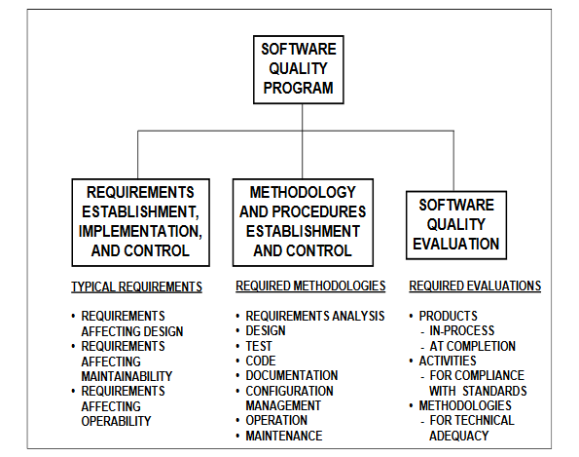
Elements of a Software Quality Program

Slide 21
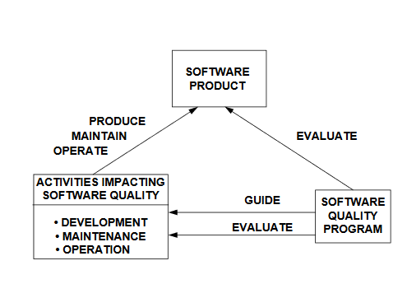

Slide 23
◆ Establishing the quality requirements for the software product.
◆ Defining, implementing, and evaluating processes and methodologies for the development, operation, and
maintenance of the software.
◆ Defining and using productivity, process quality, and product quality measures.
◆ Defining documentation requirements for the software.
◆ Performing evaluations of the software development processes and products.
◆ Planning, implementing, and managing a Software Quality Program.

Slide 24
Objective:
The objective of the software quality program is to assure the quality of:
◆ Deliverables software and its documentation.
◆ The process used to produce deliverable software.
◆ Non deliverable software.

Slide 25
Responsibility for the software quality program
◆ The persons conducting the evaluation of a product or activity shall not be the persons
who developed the product, performed the activity, or are responsible for the product
or activity. This does not prevent members of the development team from participating
in these evaluations, The contractor shall assign responsibility for the fulfillment of,
and for ensuring compliance with, the software quality program requirements.

Slide 26
Documentation for the software quality program
◆ The software quality program, including procedures, processes, and products, shall be
documented in contractor format and shall provide implementing instructions for each of
the requirements in standard. The software quality program is subject to review by
the contracting agency and may be disapproved by the contracting agency whenever
the program does not meet the requirements of the contract.

Slide 27
Software quality program planning
The contractor shall conduct a complete review of the contract to identify and make timely provision
for acquiring or developing the resources and skills required for implementing the software quality program.
▪ Objective:
The objective of the Software Quality Program Plan is to ensure that developing software is evaluated to
determine that the desired quality has been achieved.
▪ Scope:
The scope shall identify the specific ,program or project, state the purpose and provide an introduction to
the document.
▪ Referenced Documents:
This section shall identify all the applicable and referenced documents which are required for the
specific program or project.

Slide 28
Software quality program procedure, tools and records:
procedures used by SQP arc as follows:
◆ Product reviews (internal, end-of-phase),in-process reviews (peer reviews),management review,
process audits (internal),Code walkthrough, Static code analysis (Risk Class 1),FEMA (Risk
Class1),etc.
◆ Tools to be used in the SQP are:
Name, the identification number, version, and development status of the tools necessary to complete the
Software Quality Program.

Slide 29
ESTABLISHMENT OF A
SOFTWARE QUALITY PROGRAM
Tasks:
•
•
Swift and accurate collection of data.
Develop a plan for quality.

Slide 30
Scope:
◆ Planning for and conducting assessments of the quality of the software.
◆ Planning for and conducting assessments of the quality of workmanship of all contractors for the software.
◆ Planning for and conducting assessments of the quality of all work which will need to be performed for the
on-going maintain of the software.
◆ All deliverable and non-deliverable items which are to be purchased as the part of the project need to be
clearly identified and labeled.
◆ Systems boundaries need to be clearly defined.

Slide 31
Minimal quality Assurance Effort:
◆ Concentrate efforts for greatest effect.
◆ Most major system failures have been caused by interface problems.
◆ Search for risk function.
◆ Encourage developers cooperation.

Slide 32
Quality plan
The quality plan helps you schedule all of the tasks needed to make sure that your project needs of your
customer.
It comprises of two parts:
◆ The Quality Assurance Plan lists the independent reviews needed.
◆ The Quality Control Plan lists the internal reviews needed to meet your quality targets.

Slide 33
Purpose:
◆ The purpose of this Software Quality Plan is to define the techniques, procedures, and methodologies that
will be used to assure timely delivery of the software and that the development system meets the specified
requirements within project resources.
Barrier:
• Top management must understand the direct relationship of improved quality to productivity and from there to
lowering of costs and expenses
• Top management must understand that it controls the system and subsystems that determine the performance
of the people in the organization

Slide 34
Technical Definitions:
The technical definition consists of the following three parts:
◆ Requirements:
The organization must develop, manufacture and distribute consistently low-cost products
and services. The products must be what customers believe they want.
◆ Confidence:
The products must be supplied at the level of reliability which matches the client's
needs.
◆ Constant improvement:
Constant improvements od all products and all process must be made as an integral part of
the corporate culture for the client to continue a supplier as a quality procedure.

Slide 35
Creating a Successful Quality Assurance Program
A well designed Quality Assurance Program will help you effectively appraise how your internal technologies, processes and procedures are benefiting you.
Set Quality Goals for Your Business
As you define your goals, establish criteria to meet them. The standards, as you define them, will become the basis of your company’s Quality Assurance Program. Some examples of standards and criteria include reduction or elimination of:
The number of errors related to engineering or order entry for each project
The number and severity of defects related to manufacturing technology each week
The number and severity of defects related to human factors in assembly or finishing for each product
Bottlenecks associated with production workflow or supplies

Slide 36
Create Policies & Procedures
Establish & Incentivize a Quality Committee
Monitor Key Performance Indicators
It is key to use information and data as the primary basis for measuring the relative success of your Quality Assurance initiatives. Focusing on quantitate measures that show clear results provide the foundation for developing and monitoring key performance indicators (KPI). Use a computer system or data logger where appropriate. Vary the samples taken to capture any variances in the inputs. Determine how often to capture data allowing for enough time for analysis and collect the information regularly.
A few examples of KPI are:
Minutes Per Unit (MPU)
Energy Per Unit (EPU)
Number of Defects Per Unit
Direct Labor Per Unit
Excess & Obsolete Supply ($ or Units)
Number of Damage Products Per Month
Yield (SqFt/Month)

Slide 37
Implementing Change
This is the most important and hardest step. Experiment with different innovations, allowing for modest failure. Implementing the change – companywide and in individual departments – based on insights learned will allow a Quality Assurance Program to be actionable.
Quality assurance never ends. Adopting a culture of continuous improvement is worth it and over time, participation in the processes outlined above can bleed over to other parts of your business where other improvements can be achieved.
A few tips for success:
Baseline using time studies before you begin to implement insights so you can determine if they are working quickly.
Videotaping is an important tool to analyze processes. However, this can make people work faster, skewing results.
Use different batch sizes, product types and supplies in your data collection. This will help you identify patterns where possible failures may occur.
Be sure to couple input from different levels in the organization prior to implementing a new insight to get buy-in before implementing the changes.
Establish a KPI for each process and reward the team for measurable improvements.
Make one change at a time, monitor and test before moving to a new change.
Remember, people are the biggest variable in your analysis.

